Slide 1

Spotted Python
Week 8 Tutorial
BPT Diagram
Fitting a Gaussian
Spectroscopic redshift

Slide 2
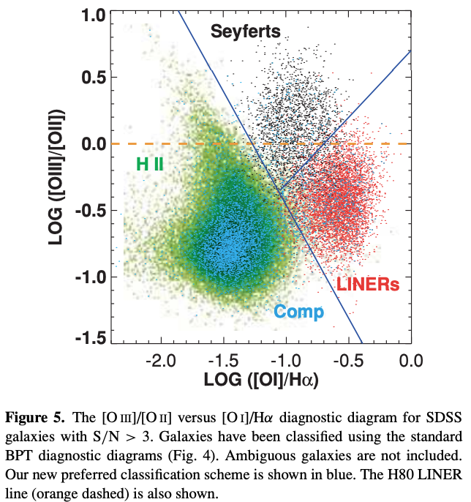

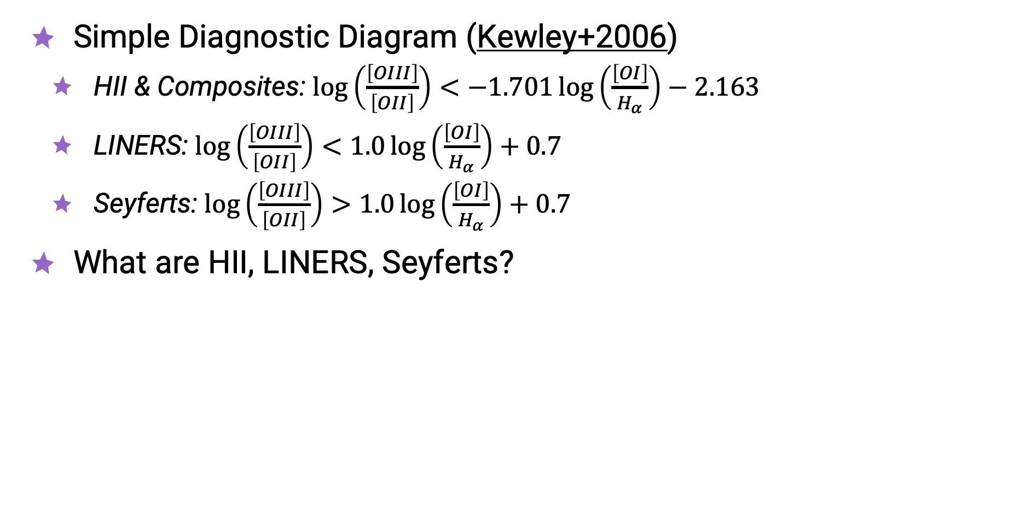
BPT Diagram
Simple Diagnostic Diagram (Kewley+2006)
  HII & Composites: $\log\left(\frac{\left[OIII\right]}{\left[OII\right]}\right)<−1.701\log\left(\frac{\left[OI\right]}{H_{α}}\right)−2.163$
  LINERS: $\log\left(\frac{\left[OIII\right]}{\left[OII\right]}\right)<1.0\log\left(\frac{\left[OI\right]}{H_{α}}\right)+0.7$
  Seyferts: $\log\left(\frac{\left[OIII\right]}{\left[OII\right]}\right)>1.0\log\left(\frac{\left[OI\right]}{H_{α}}\right)+0.7$
What are HII, LINERS, Seyferts?

Slide 3
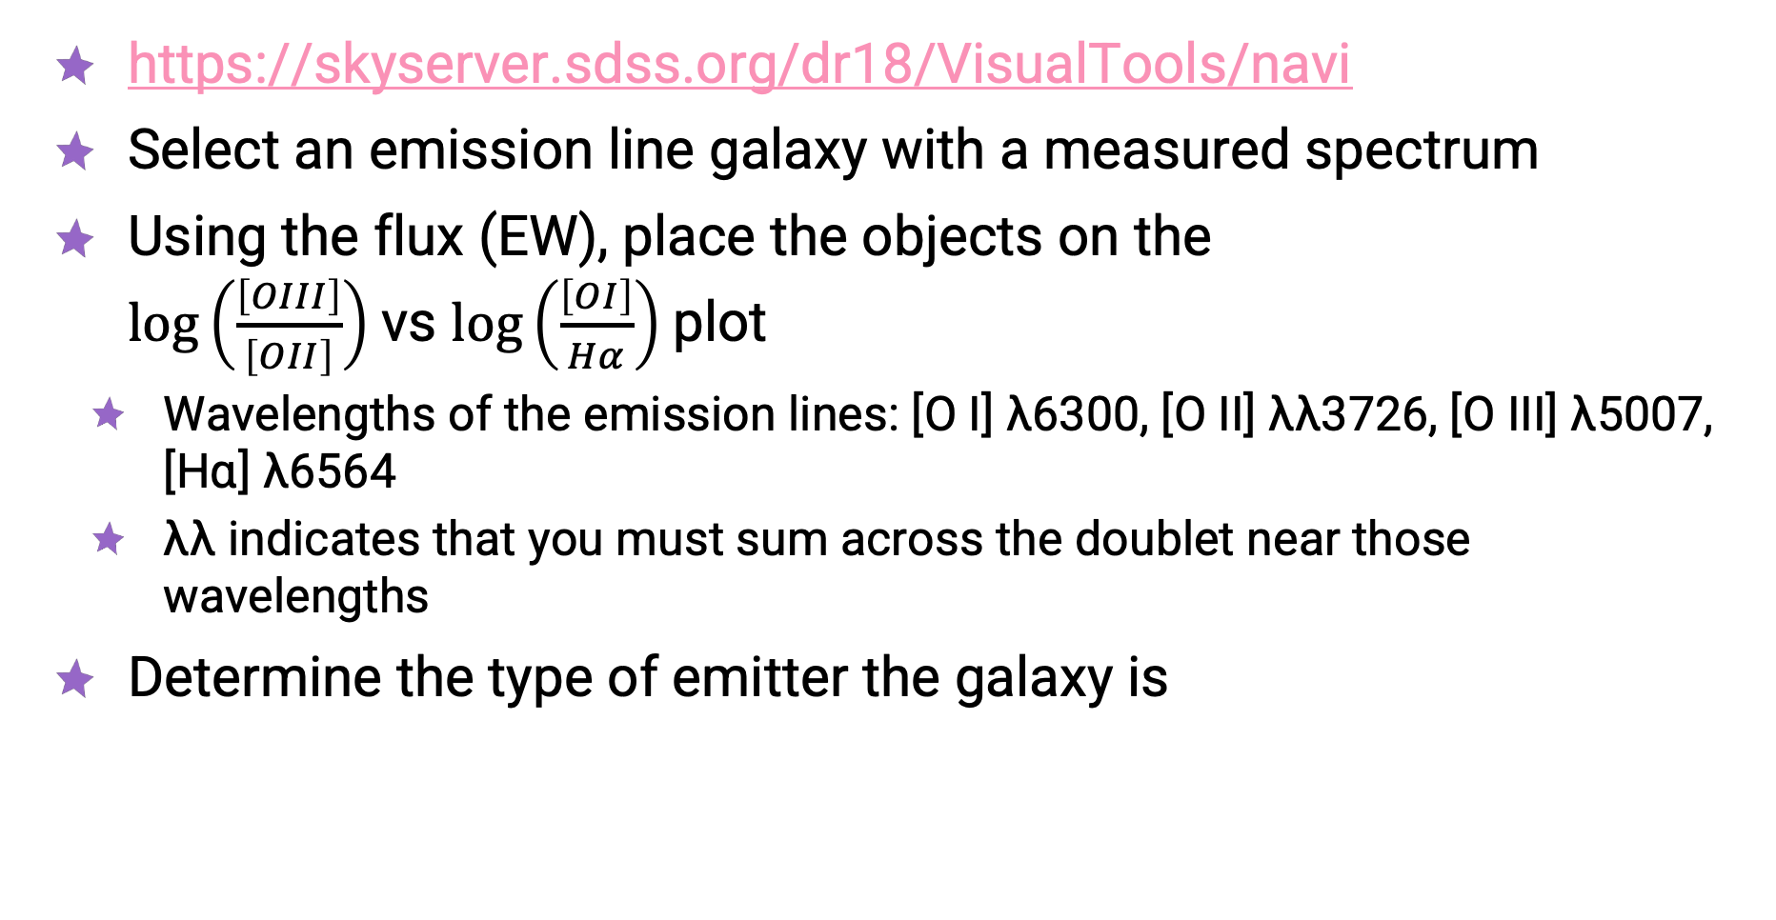
SDSS Navigate Visual Tool
https://skyserver.sdss.org/dr18/VisualTools/navi
Select an emission line galaxy with a measured spectrum
Using the flux (EW), place the objects on the
$\log\left(\frac{\left[OIII\right]}{\left[OII\right]}\right)$vs $\log\left(\frac{\left[OI\right]}{Hα}\right)$plot
  Wavelengths of the emission lines: [O I] λ6300, [O II] λλ3726, [O III] λ5007,
  [Hɑ] λ6564
  λλ indicates that you must sum across the doublet near those wavelengths
Determine the type of emitter the galaxy is

Slide 4
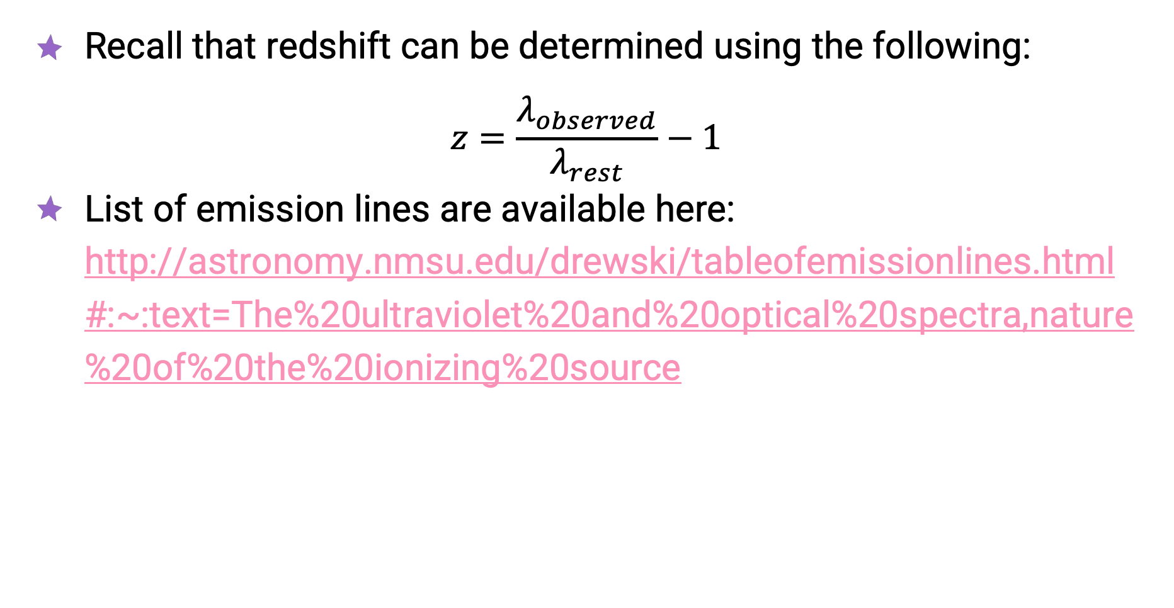
Spectroscopic Redshift
Recall that redshift can be determined using the following:
$$z=\frac{λ_{observed}}{λ_{rest}}−1$$
List of emission lines are available here: http://astronomy.nmsu.edu/drewski/tableofemissionlines.html#:~:text=The%20ultraviolet%20and%20optical%20spectra,nature%20of%20the%20ionizing%20source

